Slide 1
COMP6246 Machine Learning Technologies
Ensemble Learning:
Bagging
Dr Mohammad Soorati
School of Electronics and Computer Science
University of Southampton

Slide 2
Bootstrapping
Decision Tree
Bootstrapping
Randomly Sampled Data sets
*Draw with replacement
25% for Tree 1
25% for Tree 2

Slide 3
Boostrapping
Resampling method in which several random samples are drawn with replacement from a dataset
Example:
Original Dataset: O = [a, b, c, d]
Randomly sampled datasets: O’ = [a, a , c, d] or [b, a , d , d]
*Randomly emphasized on a or d
* Note: |O|=|O’|
Notes:
,

Slide 4

Random Forest (aka second best algorithm!)
Train group of Decision Trees
  Majority vote, average over trees, etc.
Randomness:
  Random training sets
  Features randomness (e.g., k=sqrt(n))
    Trees learn to be diverse (Uncorelatedness)
    Decreasing training time
F₁
F₁
F₂
F₂
…
F₁
…
F_{n}
F₂
F_{n}
…
F_{n}

Slide 5
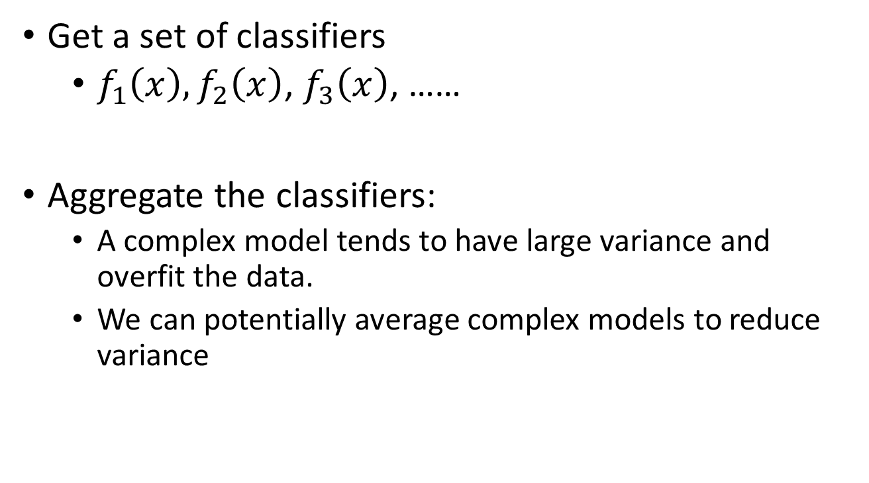
Bagging (Bootstrap aggregating)
Get a set of classifiers
  $f_{1}\left(x\right),f_{2}\left(x\right)$, $f_{3}\left(x\right)$, ……
Aggregate the classifiers:
  A complex model tends to have large variance and overfit the data.
  We can potentially average complex models to reduce variance

Slide 6
Bagging
Sampling N’ examples with replacement
N training examples
(usually N=N’)
Set 1
Set 2
Set 3
Set 4
Function
1
Function
2
Function
3
Function
4

Slide 7
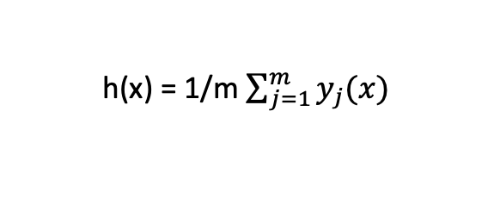
Bagging
Testing data x
Function
1
Function
2
Function
3
Function
4
y₁
y₂
y₃
y₄
Average for regression/voting for classification
h(x) = 1/m $\sum_{j=1}^{m}{y_{j}(x)}$

Slide 8

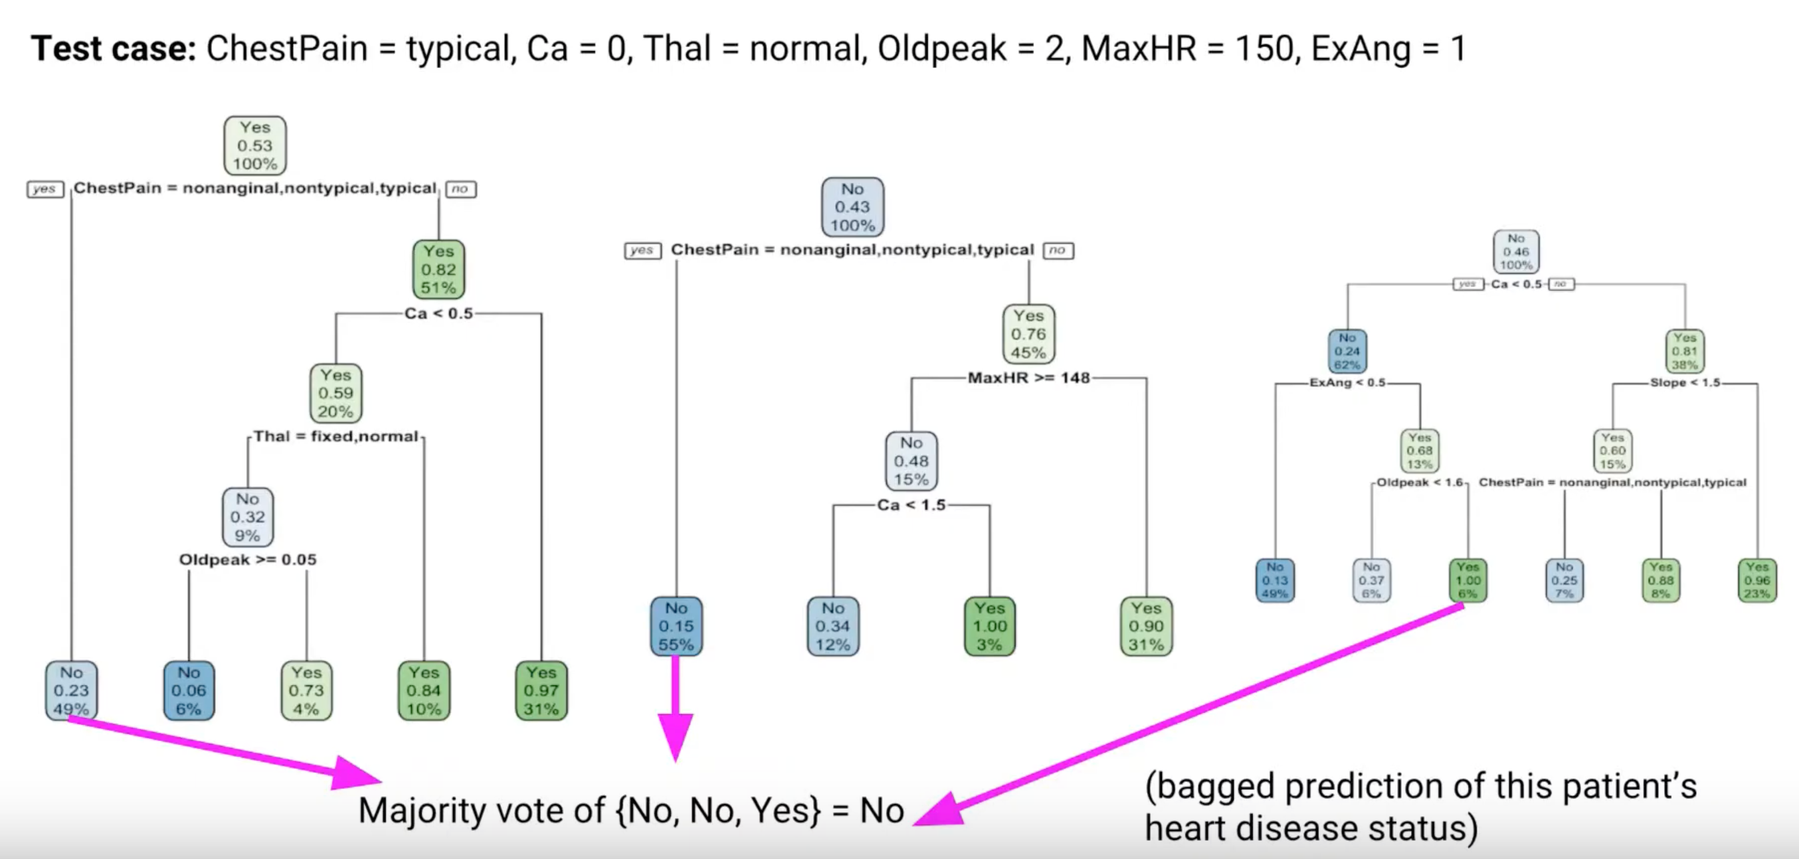
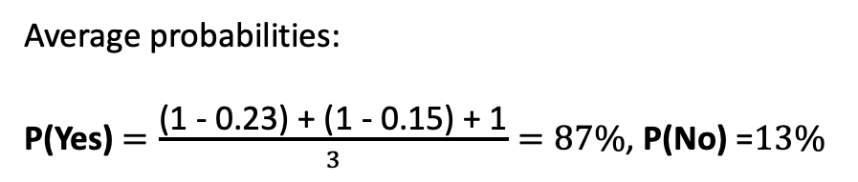
Heart Disease Diagnosis
Average probabilities:
P(Yes) $=\frac{\text{(1 − 0.23) + (1 − 0.15) + 1}}{3}=87\%$, P(No) =$13\%$

Slide 9
Bagging (Advantages & Disadvantages)
Reduces overfitting (good for high variance)
Handles missing values
Parallel Processing
Doesn’t address Bias
Low interpretability
Notes:
b/c of average its reduces overfitting.

